Slide 1
Jeffersonian America
The American Pageant
Chapter 11

Slide 2
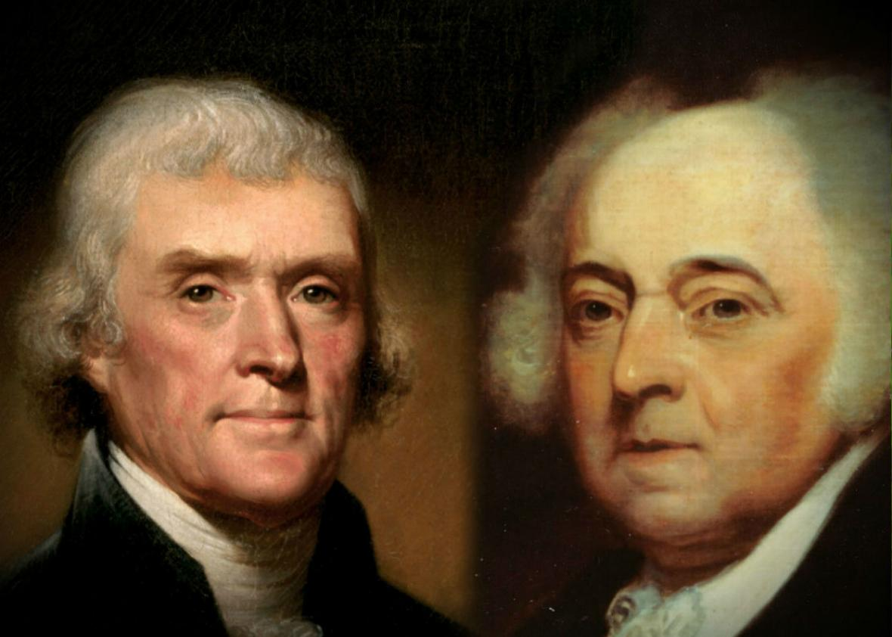
Election of 1800 and The “Whispering Campaign”
First election with political factions
Thomas Jefferson vs. John Adams
Agrarian vs. Industry
Small government vs. Big Government
Strict constitution view vs. Loose constitution view
The French problem; The Sedition problem; The illegitimate child problem; The atheist problem; etc.
The next decade sets the tone for what is to come politically
Easy to say, harder to do

Slide 3
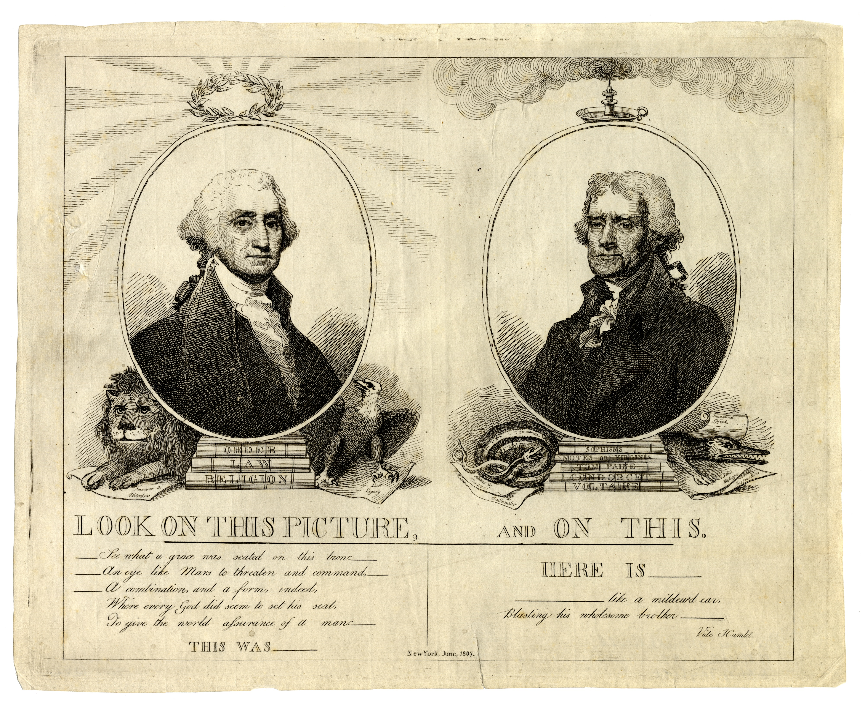
“Whispering Campaign”
1807

Slide 4
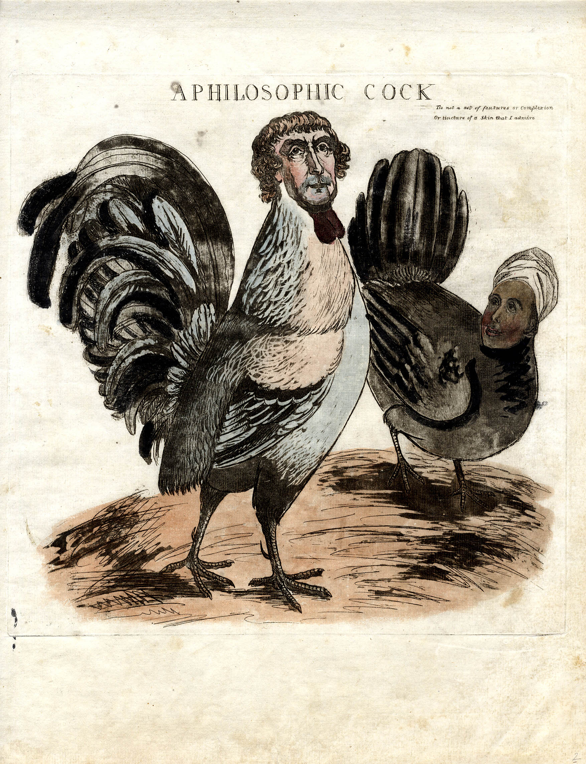
1804

Slide 5
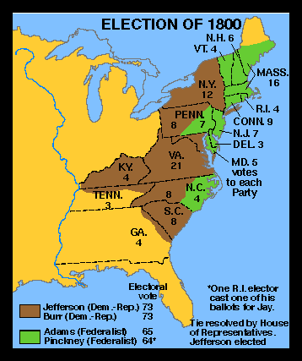
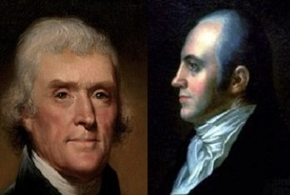
The Revolution of 1800
Jefferson wins the majority of electoral votes (73-65)
Federalists also lose the legislative branch
Wins primarily southern states, plus NY
Factors that led to his win:
Universal white manhood suffrage
3/5 Compromise
The Problem:
Aaron Burr also runs for president
Also wins 73 electoral votes
Heavily Criticized By The North!

Slide 6
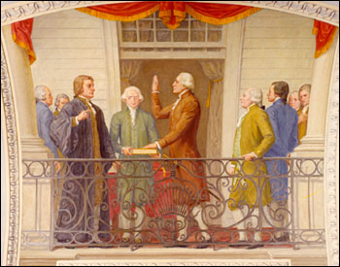
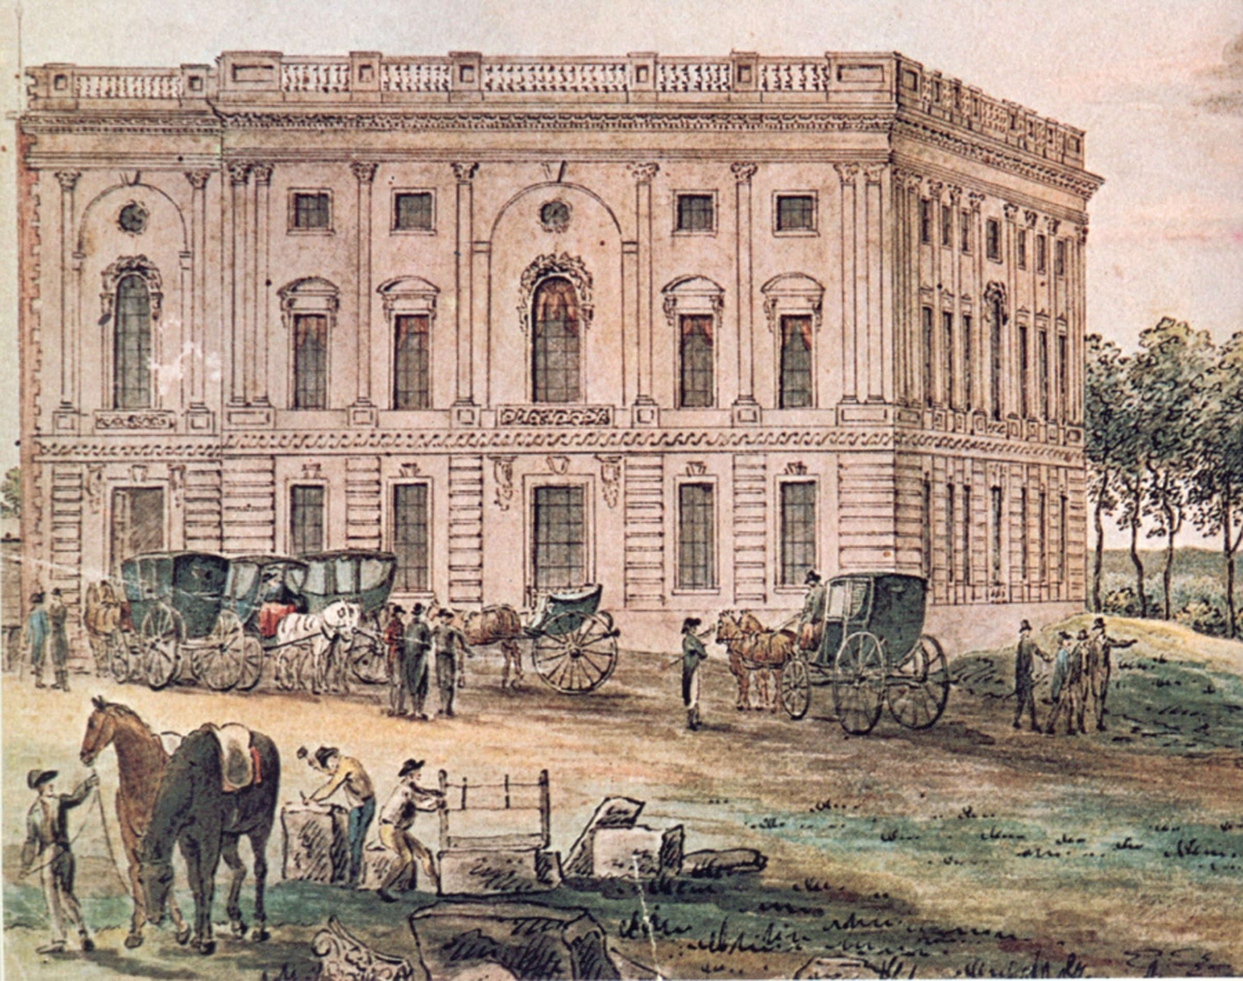
Who Wins?
Importance of
Washington, DC;
Jefferson, a man of the people
Look to the Constitution! (Article II, Section 1)
The House of Representatives
Decided by no-vote “lame duck” federalists in the House
Jefferson’s “Revolution”
Restore republican ideals
Limit the growth of the federal government
“The will of the majority is in all cases to prevail”
“The minority posses their equal rights, which the law must protect”
Peaceful transfer of power between governments, to this day!

Slide 7
Jefferson’s Personality
Two Jefferson’s
The theorizer, and the President
Dismissed few public servants
Federalists stay in power— “few die, none resign”
Charming

Slide 8
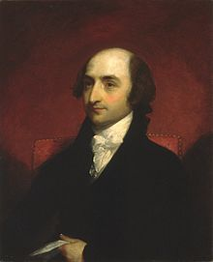
Jeffersonian Restraint
Pardoned those imprisoned under the Sedition Acts
New Naturalization Act--
Number of years to become a citizen: 14 → 5
Worked with Congress to repeal excise tax
Helped balance the budget; reduced debt
Hamilton favored debt—why?
Kept much of Hamilton’s work in place
National bank; kept tariffs
Albert Gallatin,
Secretary of the Treasury

Slide 9
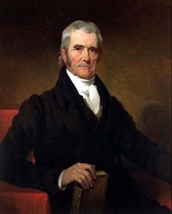
Jefferson and the Judiciary
Judiciary Act of 1801—passed by Federalists
Creates 16 federal judgeships
Adams signs commission of Federalist judges on last day in office
Midnight judges
Federalists leave their mark before exiting the white house
Protested by Jefferson supporters / Republicans
Act repealed the following year by Republicans
John Marshall—Chief Justice of the Supreme Court
A cousin to TJ. Also, a Federalist.

Slide 10
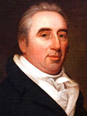
Marbury v. Madison, 1803
Secretary of State James Madison
Withholds the commission of midnight judges
William Marbury sues for delivery
Decision
Dismisses Marbury’s suit
Marbury’s appeal was unconstitutional
Establishes the principle of “judicial review”
Courts alone have the last word on constitutionality of law
Jefferson’s Response:
-Go after judges
-Samuel Chase
-Calls for impeachment
-High crimes and misdemeanors
-Not evident!
-Failed attempt
Independence and Power of Judiciary Further Established
KEY CONCEPT: JUDICIAL POWER EXPANDS!

Slide 11
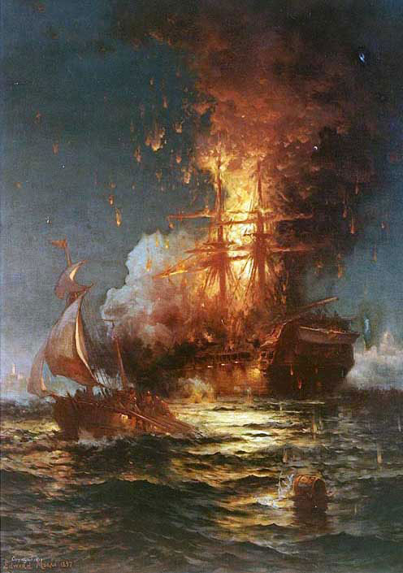
Jefferson and Foreign Policy
Wants to reduce size of military and navy
Pirates in North African Barbary States
Pay tribute, or continue to get mugged
Fighting ensues—Jefferson answers the call
“Shores of Tripoli”
Four years of fighting
Americans negotiate treaty
60,000 for captured Americans
Jefferson encourages building of more ships

Slide 12
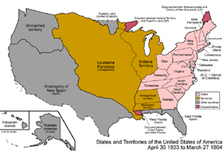
Louisiana Purchase
1800—Spain cedes trans-Mississippi / New Orleans to France
Spain no longer upholds Pickney’s Treaty –calls for revolt
1803: Jefferson sends James Monroe to Paris
The goal: buy New Orleans and land east for $10,000,000
If it fails—ally with England
Napoleon agrees to sell land—actual price of $15,000,000
Latin-American Revolutions
War with England
828,000 sq miles
Three cents / acre
Jefferson’s dilemma and proposed amendment
The goal was New Orleans—buy a wilderness for a city!

Slide 13
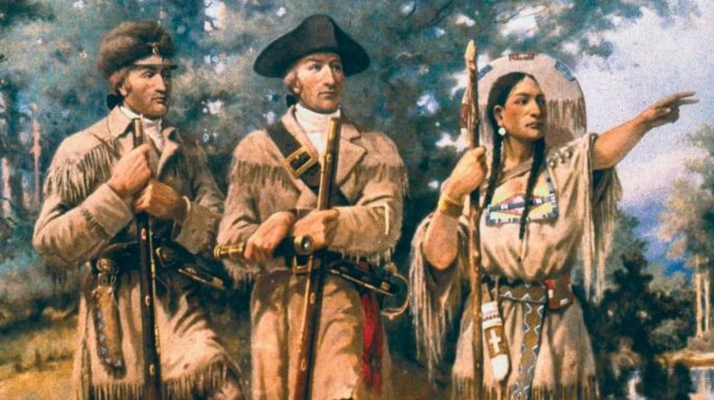
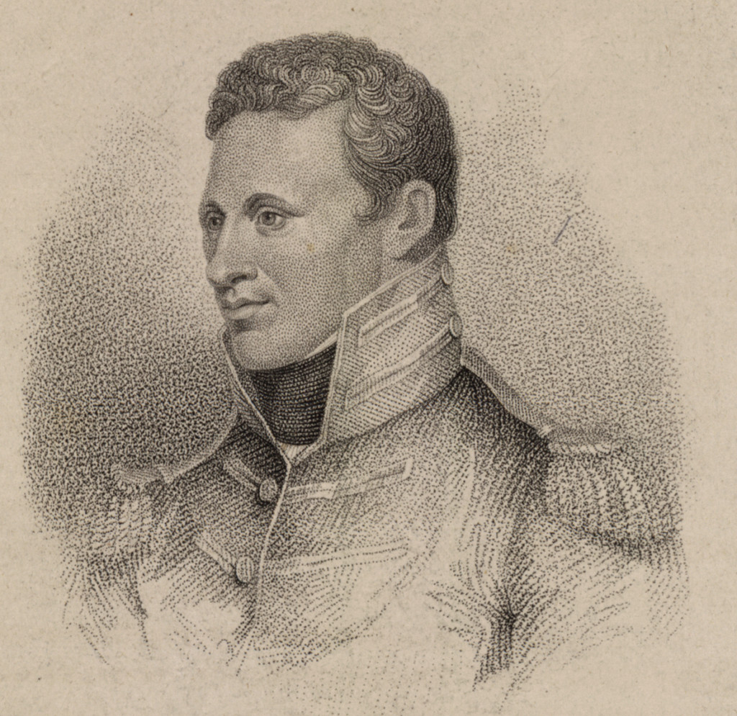
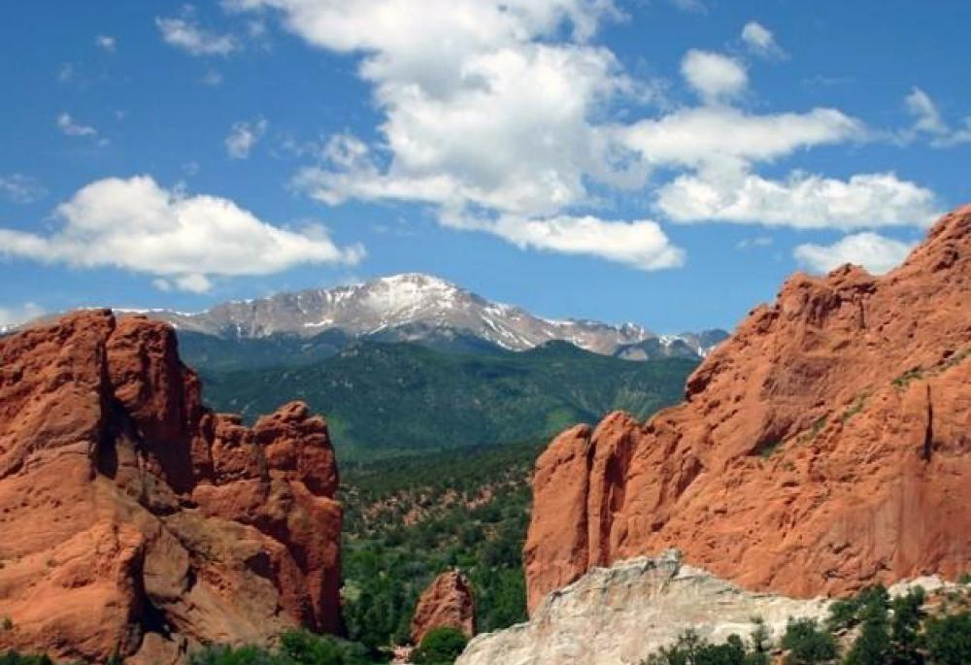
Louisiana Purchase
Doubles size of United States
Promotes Jefferson’s agrarian push
Native Americans? Slavery?
Cut off from world
Lewis and Clark—Corps of Discovery
Two-plus year journey
Trek across the country (Sacajawea)
Come back with sights / stories
Zebulon Pike

Slide 14
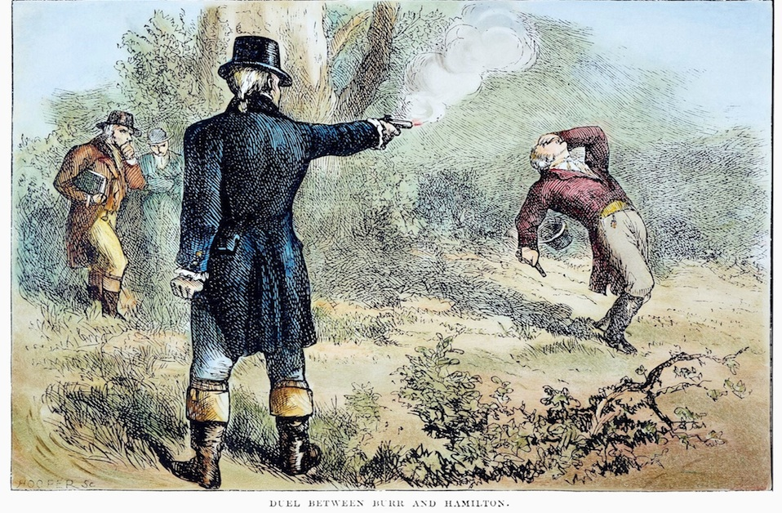
Aaron Burr
VEEP during Jefferson’s first term; dropped during 2nd
Plots to secede NE and NY from the Union
Hamilton uncovers and exposes the plan
Duel set between the two
Hamilton refuses to fire—dies.
Burr sets up more plots—failed attempts
Arrested, put on trial for treason
SCOTUS—Marshall
Must prove treason, not just intentions
Burr acquitted, fled to Europe

Slide 15
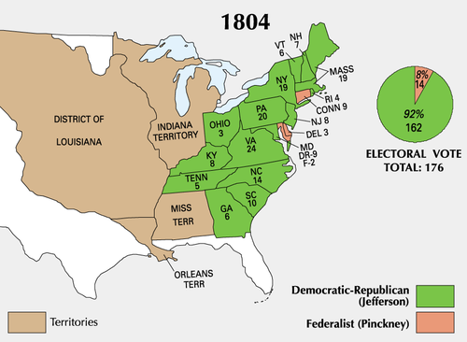
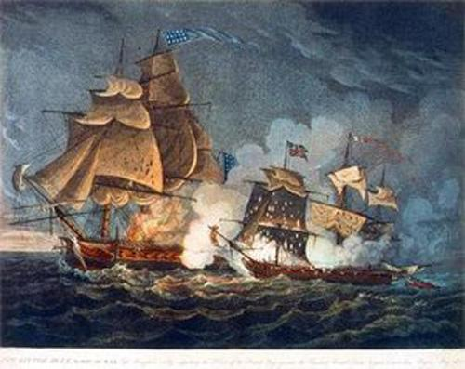
Jefferson Re-elected, 1804
Overwhelmingly re-elected
Second term not as good as first (typical)
War raging with France and England
USA caught in the middle—trade
Both countries cut off each other’s ports to foreign trade
US seamen forced into impressment by British
Chesapeake Affair
British frigate overhauls US frigate; demands surrender of deserters
Three Americans killed
Calls for war—Jefferson declines
US Neutrality is Tested!

Slide 16
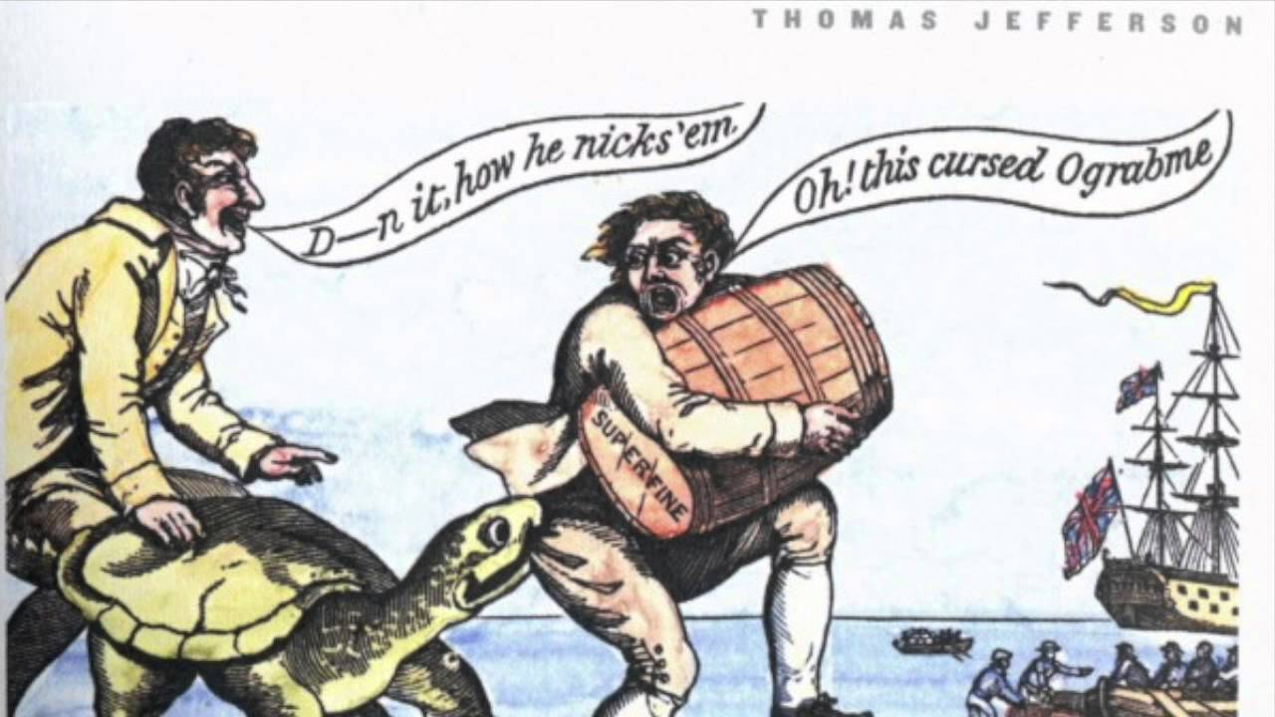
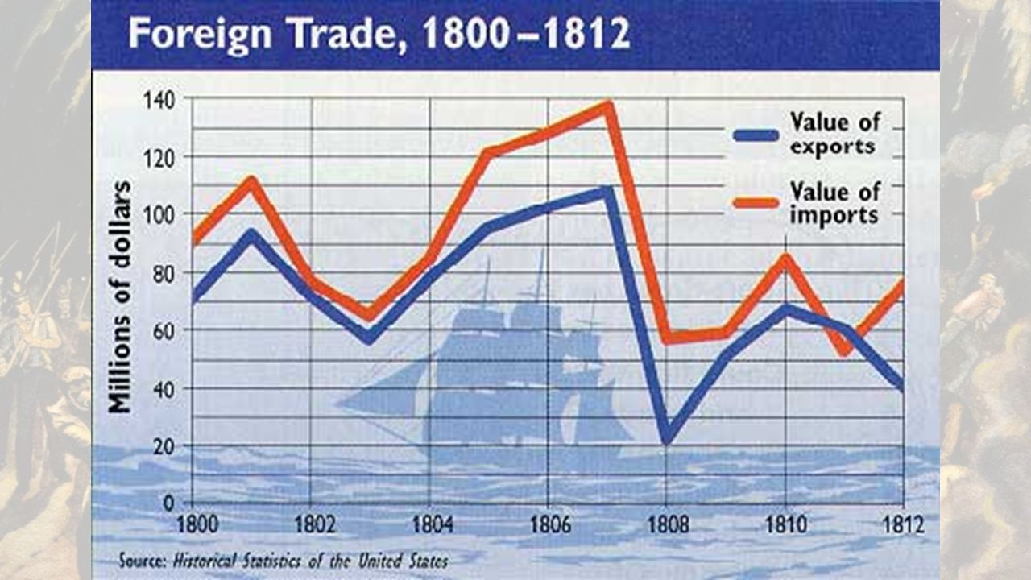
The Embargo Act
Instead of war—cut off trade
Europe relies on raw materials, food from US
Embargo Act of 1807
Forbade exports of all goods from the USA
Neutrality enforced
Backfires—plenty of wealth in England and France
Cuts of trade with ourselves—creates more economic problems
Especially the poor (cotton, grain, tobacco, etc.)
Smuggling with Canada
Public Outcry leads to the Non-Intercourse Act—
Re-opens trade with all nations, except France and England—helps fuel Industrial Revolution in America!*

Slide 17
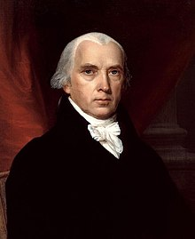
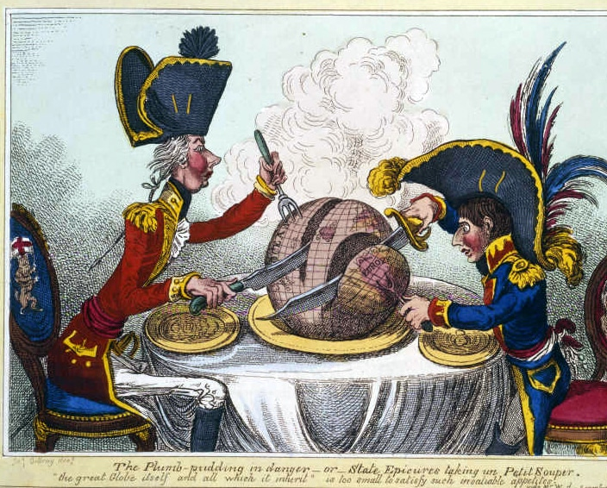
Madison
Jefferson out after two terms, James Madison in
Weaker president than Jefferson—at mercy of Congress
Congress passes Macon’s Bill No. 2
Embargo dismantled
Open up trade with Britain OR France; close off trade with the other [RESPECT OUR NEUTRALITY]
Napoleon agrees to it—political and economic
Also fails—also cuts off trade with England
War?

Slide 18
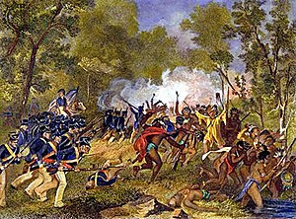
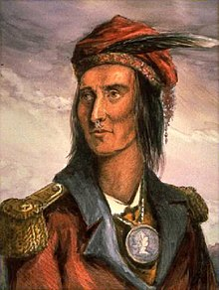
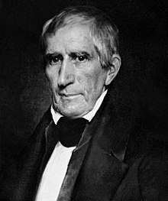
War Hawks
Advocate ware against England (and Natives)
Natives fight back→ Tecumseh and Tenskwatawa
Build confederacy of tribes
Never cede land; give up trade
William Henry Harrison (governor of Indiana Territory)
Gathers army; goes to Tecumseh’s headquarters
Battle of Tippecanoe
Defeat of Natives

Slide 19
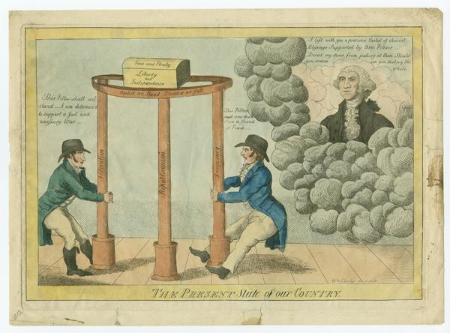
War of 1812
War Hawks—also focused on England [RESPECT OUR NEUTRALITY]
England arming Natives against US
Want Canada as part of US
Fight to prove republicanism and democracy works!
If not, you’re discredited
Madison asks for a declaration of War on June 1, 1812
Congress obliges—close vote [sectional]
Federalists vs. Anti-Federalist
Pro-England vs. Anti-England

Slide 20
Homework Due October 30!

